Slide 1


Understanding Software Delivery Delay
Daniel Alencar da Costa
Supervisor: Uirá Kulesza
Co-supervisor: Ahmed E. Hassan
Notes:
Hello, my name is Daniel Alencar da Costa. I am supervised by Uira Kulesza and Ahmed Hassan,
And Im going to present my thesis proposal entitled as Understanding Software Delivery Delay

Slide 2
Agenda
Introduction
Conclusion
Background
Studies

Slide 3
Agenda
Introduction
Conclusion
Background
Studies

Slide 4
Agenda
Introduction
Conclusion
Background
Studies

Slide 5
Agenda
Introduction
Conclusion
Background
Studies

Slide 6
Agenda
Introduction
Conclusion
Background
Studies

Slide 7
Introduction
Notes:
Before showing some of our findings I will be explaining some background concepts that are necessary to understand our research

Slide 8
An software issue can represent…
Notes:
A software issue can be represented by

Slide 9

Notes:
A bug within the system

Slide 10

Notes:
An enhancement that is needed for the system to perform better

Slide 11

An issue can represent a bug, an enhancement, or a new feature
Notes:
And a brand new feature that the system must accomodate

Slide 12

After an issue is addressed it may still suffer delay to be delivered
Notes:
-> However, after an issue has been addressed, users may still wait a long time to see such addressed issue reflected in the software system, so the users can be benefited from them. -> We observe that some users become curious about when an addressed issue will land into an official release once such an issue is addressed.

Slide 13
There is a lack of empirical studies to understand delivery delay
Notes:
The problem is that there is a lack of empirical research that study the delay to release addressed issues

Slide 14

There is a lack of empirical studies to understand delivery delay
Fixing
Notes:
- Previous research has been invested in the factors that have impact on the time that it takes to fix issues

Slide 15

There is a lack of empirical studies to understand delivery delay
Fixing
Triaging
Notes:
Or even before, in the time that it takes to triage issues, so developers can work on them accordingly

Slide 16
The understanding of which factors impact on delivery delay remains as a open challenge
Notes:
So the understanding of which factors in the development process that lead to delivery delay is still an open question that has to be empirically investigated.

Slide 17
Once issues are addressed why do they still suffer delivery delay?
Notes:
In this context, the main question of this thesis is “ Once issues are addressed why do they still suffer delivery delay?”

Slide 18
Background
Notes:
Before showing some of our findings I will be explaining some background concepts that are necessary to understand our research

Slide 19
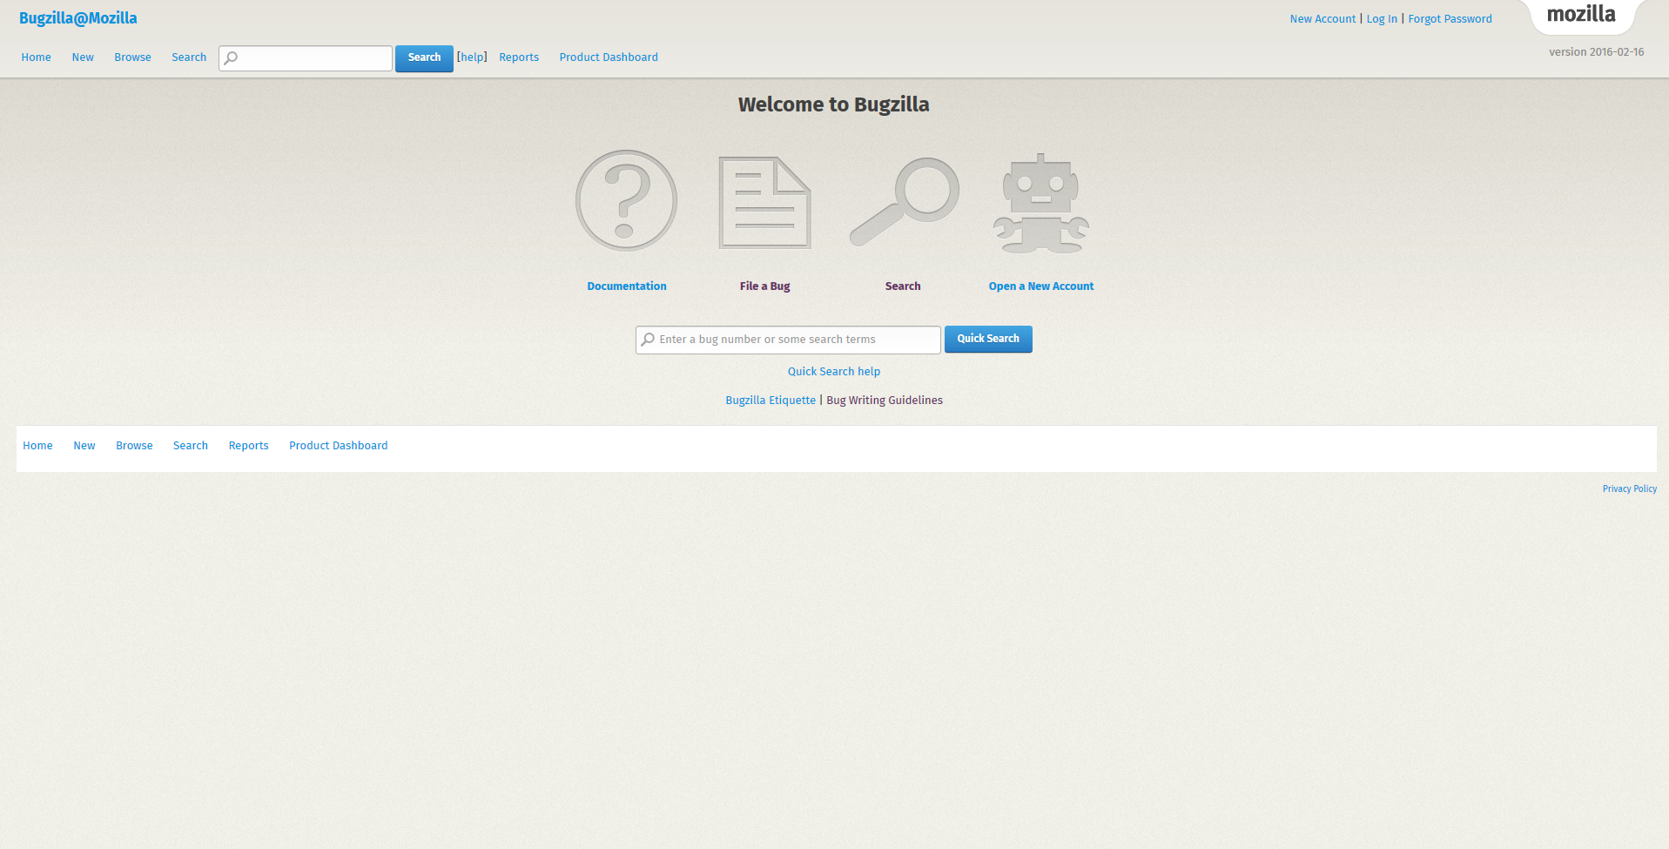
We use the term issue to broadly refer to bugs, enhancements, and new features reports
Notes:
When we report our finding we use the term issue, to referto to either bug reports, new feature requests, and enhancements or improvements, that are found in the Bugzilla or any other issue tracking systems that accommodates these concepts
that is, we don’t study one of the types of issue reports specifically

Slide 20
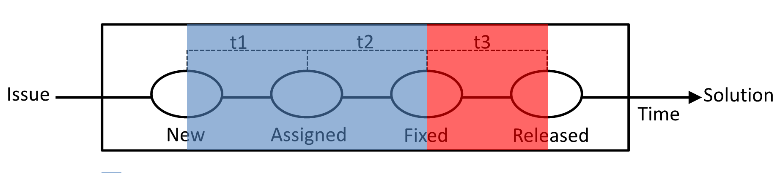
We use the term delivery delay to refer to the time that it takes to deliver an addressed issue
Our work
Notes:
We use that tem ‘delivery delay’ to refer to the time that it takes to release an addressed issue since it is addressed,
So basically this picture represent a simple lifecycle of issues. The blue part was investigated by previous research, whereas our main focus in on the red part, the time that it takes from when an issue is addressed
To when an issue is fixed.

Slide 21

A release cycle is the time that it takes to develop and ship a new version of the software
1.0
2.0
Time
Notes:
We call by release cycle, the time between one user intended version to another user intended version. For example, the time in days that it takes from version 1.0 to version 2.0

Slide 22
Rapid releases have shorter release cycles
1.0
2.0
Time - traditional
1.0
2.0
Time - rapid
Notes:
In this regard , rapid releases are those releases that are shipped from shorter release cycles, let’s say , in the scale of days and weeks, whereas more traditional release cycles may deliver releases between 12 to 18 months.

Slide 23
Empirical Studies
Notes:
Once we looked at some backgrounds concepts we are ready to talk about our empirical studies.

Slide 24

Understanding Delivery Delay (Study 1)
Earlier versions of this work are published in the proceedings of ICSME’14 and submitted to EMSE
Notes:
This study actually accommodates two papers, one of them was published in the proceedings of ICSME 2014 and one extension is submitted to EMSE journal

Slide 25

We may think that to fix a bug is enough to satisfy an interested user
Notes:
So first of all, we may think that to fix issues is what leads to users satisfaction. This seems natural

Slide 26
Prediction models and bug detection approaches were invented to help developers
Notes:
Because of this, approaches were invented to help developers to fix bugs, for example, to find similar bugs , to find possible buggy files, so developers could fix bugs more quickly

Slide 27
Users may still wait for a long time to see the fixed bug reflected in the software system
Notes:
Nevertheless, to fix a bug, or to implement a new feature is not enough to satisfy users, since users are willing to see such new software content available in the systems

Slide 28



We set out to empirically study the delivery delay of three open source systems
Notes:
With these challenges in mind, we set up to empirically study three open source systems regarding delivery delay: Firefox browser, Eclipse IDE, and ArgoUML . We study eclipse JDT more especifically

Slide 29
We set out to empirically study the delivery delay of three open source systems
14,530 issues
3,344 issues
3,121 issues
Notes:
In total we study almost 30k issues

Slide 30
We set out to empirically study the delivery delay of three open source systems
14,530 issues
3,344 issues
3,121 issues
15 releases
11 releases
17 releases
Notes:
15 releases for firefox, 11 releses for eclipse and 17 releases for argouml

Slide 31
We set out to empirically study the delivery delay of three open source systems
14,530 issues
3,344 issues
3,121 issues
15 releases
11 releases
17 releases
Rapid
Traditional
Traditional
Notes:
Firefox is rapid, eclipse is traditional and argouml is traditional

Slide 32


We collect data based on release notes information
Release Notes
Notes:
We collect our data using release notes.

Slide 33
We collect data based on release notes information
#14
#15
#16
link
Release Notes
List of Integrated
Bug Ids
Notes:
We extract the issue IDs from the release notes, so we link such ids to those releases,

Slide 34

We collect data based on release notes information
#14
#15
#16
link
link
Release Notes
List of Integrated
Bug Ids
Issue Tracking System (ITS)
Notes:
And then we collect the information about those issues from the issue tracking system.

Slide 35
We measure delivery delay in two ways: release delay and abnormal delay
Notes:
Then we measure two types of delivery delay,.

Slide 36
Release Delay
Notes:
I’ll first talk about release delay

Slide 37
We measure release delay by counting how many releases an addressed issue missed before being released
Time
Notes:
Release delay is the number of releases that

Slide 38

We measure release delay by counting how many releases an addressed issue missed before being released
Time

Slide 39

We measure release delay by counting how many releases an addressed issue missed before being released
Time

Slide 40
We measure release delay by counting how many releases an addressed issue missed before being released
After 3
Time

Slide 41
Are issues often delayed after being addressed?

Slide 42
Are issues often delayed after being addressed?
Can we accurately explain how many
releases an addressed issue will be
delayed?

Slide 43
Are issues often delayed after being addressed?
Can we accurately explain how many
releases an addressed issue will be
delayed?
What are the most influential attributes for estimating release integration delay?

Slide 44
Are issues often delayed after being addressed?
Can we accurately explain how many
releases an addressed issue will be
delayed?
What are the most influential attributes for estimating release integration delay?
Measuring Release Delay

Slide 45
Are issues often delayed after being addressed?
Can we accurately explain how many
releases an addressed issue will be
delayed?
What are the most influential attributes for estimating release integration delay?
Measuring Release Delay
Building Explanatory Models

Slide 46
Are issues often delayed after being addressed?
Can we accurately explain how many
releases an addressed issue will be
delayed?
What are the most influential attributes for estimating release integration delay?
Measuring Release Delay
Building Explanatory Models
Identifying Top Influential Factors

Slide 47
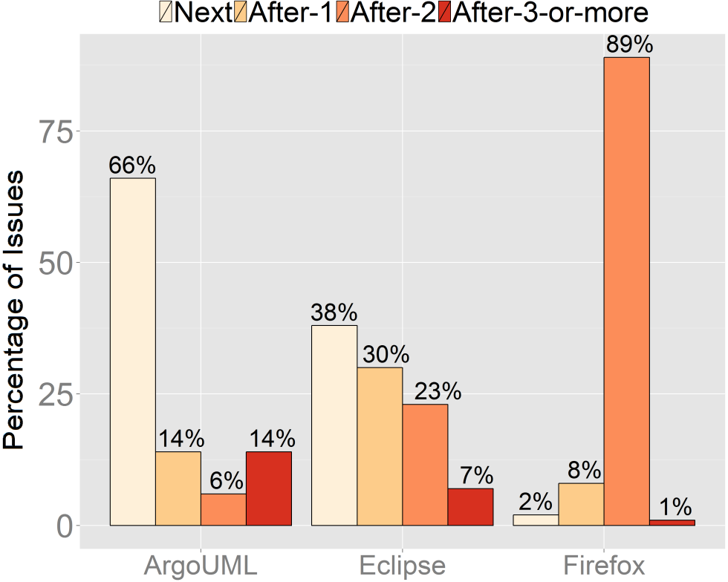
Issues are usually delayed in the rapid release cycle system

Slide 48
Issues are usually delayed in the rapid release cycle system
34%

Slide 49
Issues are usually delayed in the rapid release cycle system
60%

Slide 50
Issues are usually delayed in the rapid release cycle system
98%

Slide 51
Issues are unlikely to be delayed solely because they were addressed close to an upcoming release
Notes:
One would expect that issues are being delayed because they are being addressed close to an upcoming release.

Slide 52
Issues are unlikely to be delayed solely because they were addressed close to an upcoming release
1.0
2.0
Notes:
Then, we study how close issues were addressed before the next upcoming release. So let’s say that we have our release cycle here from version 1,0 to 2.0

Slide 53
Issues are unlikely to be delayed solely because they were addressed close to an upcoming release
1.0
2.0
Notes:
Then we have a bug that is fixed sometime in this release cycle.

Slide 54
Issues are unlikely to be delayed solely because they were addressed close to an upcoming release
1.0
2.0
Notes:
We count how many days such issue was addressed before the next upcoming release.

Slide 55
Issues are unlikely to be delayed solely because they were addressed close to an upcoming release
1.0
2.0
10 days
15 days
Notes:
Let’s say that this issue was addressed 10 days before the next upcoming release. And let’s say that the release cycle has 15 days

Slide 56
Issues are unlikely to be delayed solely because they were addressed close to an upcoming release
1.0
2.0
10 days
15 days
10/15 = 0.66
Notes:
We obtain the ratio between the number of days to an upcoming release to the number of days of the release cycle. The higher this ratio the farther an issue was addressed from an upcoming release.
We call this ratio as addressing stage

Slide 57
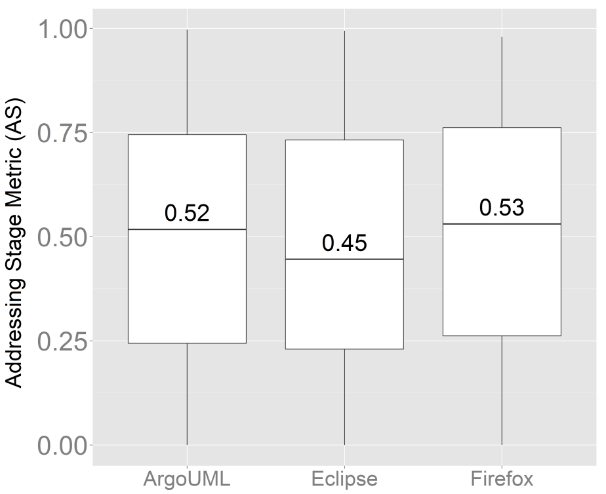
Issues are unlikely to be delayed solely because they were addressed close to an upcoming release
Notes:
When we analyze the distributions of the delayed issues, we observe that the median values of the addressing stage metric are close to 0.50 and that the boxes are somewhere between 0.75 and 0.25,
Which indicates that it is unlikely that the issues are being delayed solely because they are being addressed close to an upcoming release.

Slide 58
Our explanatory models outperform naïve approaches when estimating how many releases an addressed issue will miss
Notes:
Moreover, our explanatory models can explain how many releases a given addressed issue will miss.

Slide 59
Our explanatory models outperform naïve approaches when estimating how many releases an addressed issue will miss
ROC areas > 0.74
Notes:
Our roc areas are above 0.74 when explaining how many releases an addressed issue will be delayed by

Slide 60
We find that the workload of integrators is a top most important factor in all of the studied systems
Notes:
As for the important factors we find that workload is the metric with larger impact in all of our models. We measure workload by counting how many addressed issues are competing to be integrated into an upcoming release. The higher the number of addressed issues that are competing the higher the workload of integrators.

Slide 61
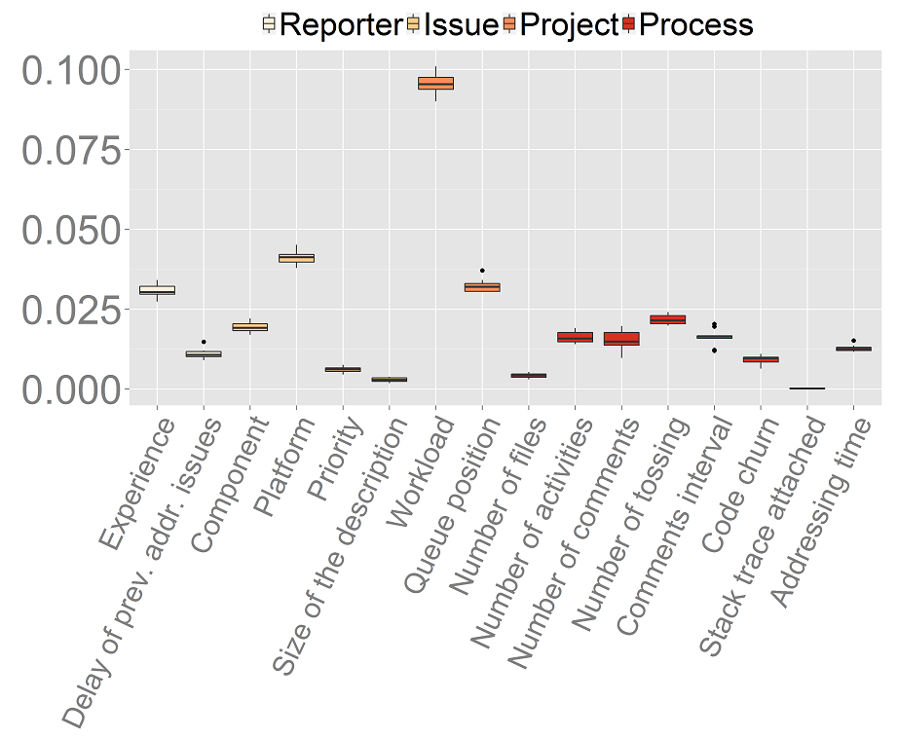
Notes:
Here we see the obtained importance scores for our 10-fold runs in the ArgoUML projects. We can notice that workload stands out from the other metrics such as the number of files of a given addressed issue or the number of comments that were needed to address a given issue.

Slide 63
We also find that priority and severity have little impact on release delay
Notes:
Finally, we also find that, surprisingly , priority and severity have little importance in our models to indicate if an addressed issue is going to be delayed or not. For instance,

Slide 64
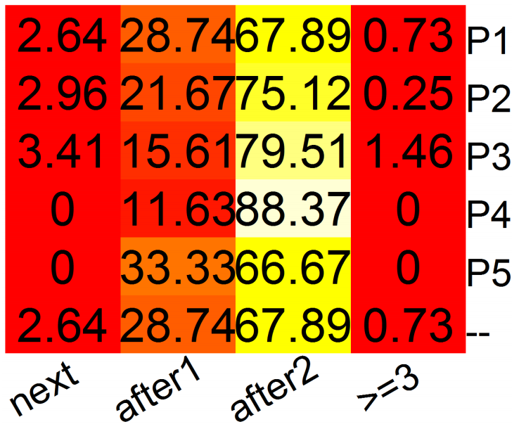
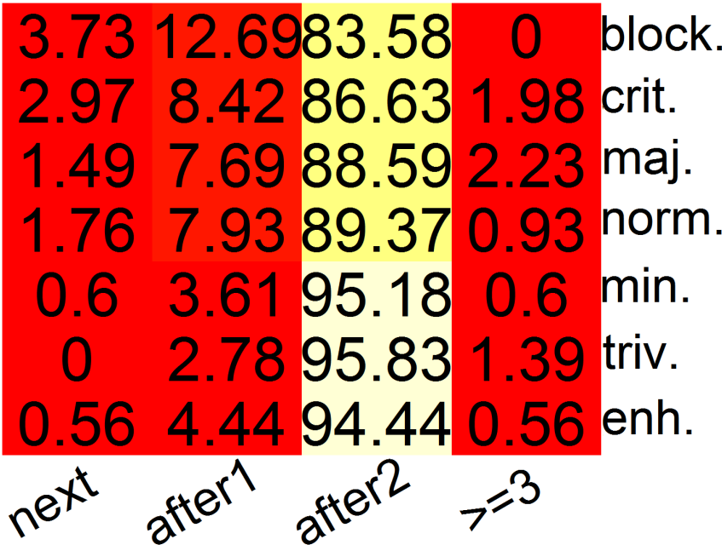
We also find that priority and severity have little impact on release delay
Priority
Severity
Notes:
Finally, we also find that, surprisingly , priority and severity have little importance in our models to indicate if an addressed issue is going to be delayed or not. Here we have some heatmaps for the firefox system. The lighter the color the higher the number of data instances . For example we can see that 68 of p1 issues
Are delayed by two releases and about 84% of blocking issues are delayed by 2 releases as well.

Slide 65
Abnormal Delay
Notes:
Now we are going to talk about abnormal delay

Slide 66
Since release delay may vary along projects, we measure the abnormal delay of each project
Notes:
We measure abnormal delay because release delay may vary along the projects, so what can be an abnormal delay to one project can be a common delay to another one

Slide 67
We measure abnormal delay based on the median of days to release addressed issues in a project
Notes:
So, here is how we measure abnormal delay.

Slide 68
We measure abnormal delay based on the median of days to release addressed issues in a project
Delay in Days
Notes:
Let’s say that our data has

Slide 69
We measure abnormal delay based on the median of days to release addressed issues in a project
Delay in Days
Notes:
And this is how our data is spread. Let’s say some issues took few days to be released, wheareas other issues took several days to be releasesd

Slide 70
We measure abnormal delay based on the median of days to release addressed issues in a project
Delay in Days
Notes:
We then take the median

Slide 71
We measure abnormal delay based on the median of days to release addressed issues in a project
Delay in Days
Delay
Abnormal Delay
Notes:
And we divide what is normal delay and abnormal delay

Slide 72
Can we explain which addressed issues will take longer to be integrated than most others?
Notes:
So our research question are:

Slide 73
Can we explain which addressed issues will take longer to be integrated than most others?
What are the most influential attributes for estimating abnormally delayed issues?

Slide 74
Can we explain which addressed issues will take longer to be integrated than most others?
What are the most influential attributes for estimating abnormally delayed issues?
Does the delivery delay of addressed issues relates to the components that they are being modified?

Slide 75
Can we explain which addressed issues will take longer to be integrated than most others?
What are the most influential attributes for estimating abnormally delayed issues?
Does the delivery delay of addressed issues relates to the components that they are being modified?
Building Explanatory Models
Notes:
For the first rq we also build prediction, in this case also random forest

Slide 76
Can we explain which addressed issues will take longer to be integrated than most others?
What are the most influential attributes for estimating abnormally delayed issues?
Does the delivery delay of addressed issues relates to the components that they are being modified?
Building Explanatory Models
Identifying Top Influential Factors

Slide 77
Can we explain which addressed issues will take longer to be integrated than most others?
What are the most influential attributes for estimating abnormally delayed issues?
Does the delivery delay of addressed issues relates to the components that they are being modified?
Building Explanatory Models
Identifying Top Influential Factors
Measuring Delivery Delay per Components

Slide 78
Our models can accurately estimate if an addressed issue will be abnormally delayed
ROC areas > 0.87
Notes:
For the first RQ, we observe that our models can accurately estimate why addressed issues will be abnormally delayed, for instance, our ROCs are above 0.87

Slide 79
We find that workload and the timing (queue position) to address issues are the most important factors to explain abnormally delayed issues
Notes:
Then we find that metrics such as workload and the timing to address issues are the most important metrics in our models. The timing to address an issue basically is the moment when the issue was addressed during the release cycle, if it was addressed early or if it was addressed later.

Slide 80
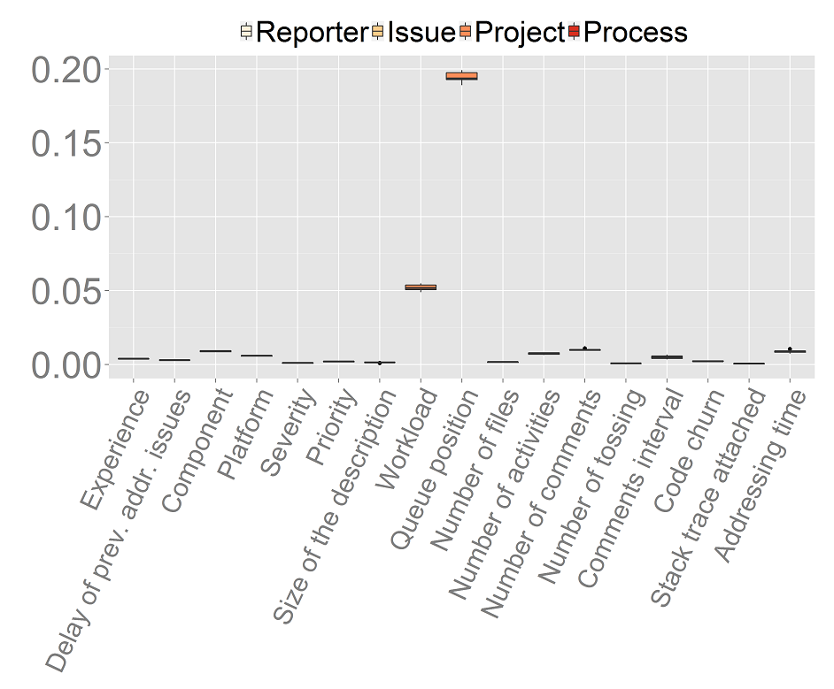

Slide 82
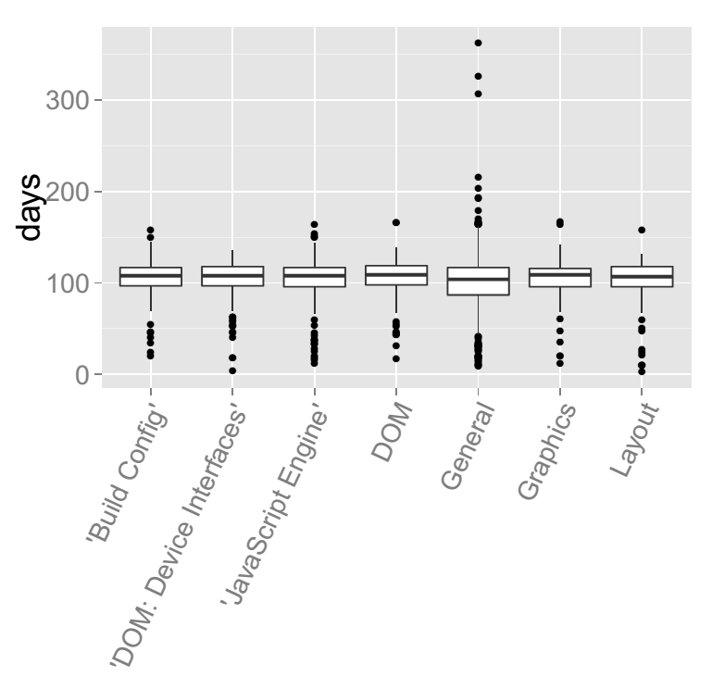
We find that components are unlikely to be related to delivery delay measured in days
Notes:
We also find that, even though, component appears to be important when measuring release delay. When we measure delivery delay in days, components are not that strong to distinguish which addressed issues are going to take more time. For instance these are the distributions of firefox addressed issues. We can notice that the General component has a higher skew in the data, and we believe that it’s because such category may accommodate a larger range of type of issues.

Slide 83
We find that issues are unlikely to be delayed solely because they were addressed close to a code freeze period
Notes:
We also investigate the code freeze period of a release cycle. We do that to complement the analysis of the addressing stage metric that we saw before.

Slide 84
We find that issues are unlikely to be delayed solely because they were addressed close to a code freeze period
1.0
2.0
10 days
15 days
Notes:
For instance we verified the time that an issue was addressed close to an upcoming release

Slide 85

We find that issues are unlikely to be delayed solely because they were addressed close to a code freeze period
1.0
2.0
10 days
15 days
Notes:
However, this time we took into account the code freeze period, in which contributions are usually frozen in order to stabilize the code to ship a release.
So, are addressed issus being delayed because they are being addressed too close to a code freeze period?

Slide 86
We find that issues are unlikely to be delayed solely because they were addressed close to a code freeze period
1.0
2.0
8 days
15 days
Notes:
So in our metric, instead of counting 10 days to a release, we count 8 days to an upcoming code freeze period

Slide 87
We find that issues are unlikely to be delayed solely because they were addressed close to a code freeze period
1.0
2.0
8 days
15 days
8/15 = 0.53
Notes:
Then, we compute the ratio. Again, the higher the ratio the farther the issue was addressed with respect to an upcoming code freeze period

Slide 88
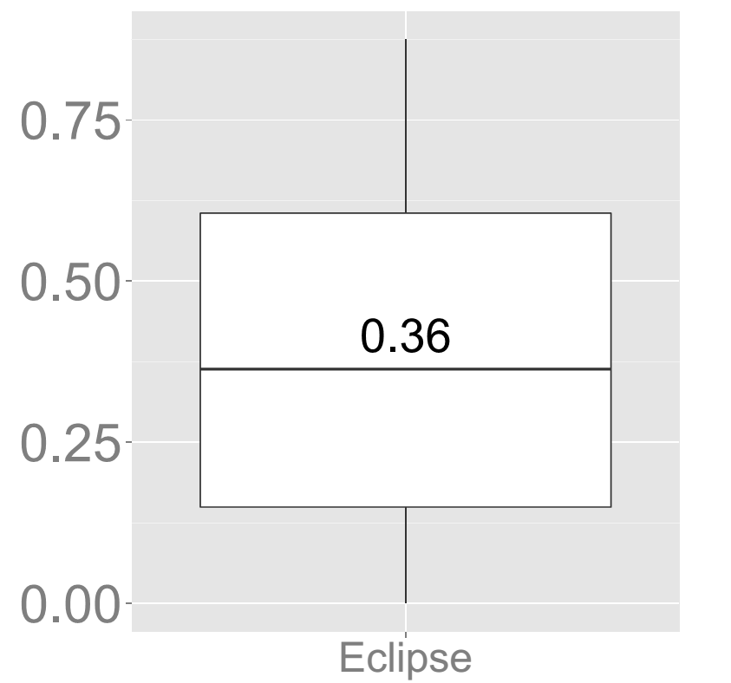
We find that issues are unlikely to be delayed solely because they were addressed close to a code freeze period
Notes:
We find that the median addressing stage is 0.36 which for a release cycle of 112 days (which is the median for eclipse). This would be a median of 40 days (more than a month) before an code freeze period.
Does we find that it is unlikely that addressed issues are being delayed solely because they are being addressed close to an upcoming code freeze period

Slide 89
Impact of Rapid Release Cycle on Delivery Delay (Study 2)
An alternative version of this work was submitted to MSR’16
Notes:
Now I.m gonna talk about our second study which is about the impact of a release cycle in the delivery delay of addressed issues. Another version of this work is submitted to MSE’16.

Slide 90

Short release cycles are usually thought to be associated with faster delivery of software
Notes:
We all know that short release cycles are associated with faster delivery of new software content. For example, the agile methodologies came up with the concept of short iterations to release software faster and to embrace the changing environment of software development

Slide 91
There is a lack of empirical studies to check if rapid releases lead to faster delivery of addressed issues
Notes:
However, we observe a lack of empirical studies to understand if shorter release cycles are actually strongly associated with the faster delivery of new software

Slide 92
Previous research has invested in studying how rapid releases impact on the speed to fix issues
Notes:
The existing research has compared the impact of release cycles in the time to fix bugs, and in the quality assurance activities such as tests and reopening of bugs. However, we observe a lack of such studies with respect to delivery delay

Slide 93
We set out to compare how rapid releases of Firefox impact on the speed to deliver addressed issues of that system
Notes:
Therefore, we set out to compare how rapid releases of Firefox impact on the speed to deliver addressed issues of that system. Firefox is a good fit, because it an open source software that we can study the transition of a traditional release cycle to a rapid release cyce.

Slide 94

We set out to compare how rapid releases of Firefox impact on the speed to deliver addressed issues of that system
Traditional
Rapid
Notes:
We then compare the traditional releases of firefox to the rapid releases of the firefox

Slide 95
We set out to compare how rapid releases of Firefox impact on the speed to deliver addressed issues of that system
Traditional
Rapid
111 releases
73 releases
Notes:
111 releases to the traditional ones, 73 releases to the rapid ones

Slide 96
We set out to compare how rapid releases of Firefox impact on the speed to deliver addressed issues of that system
Traditional
Rapid
111 releases
73 releases
34,673 issues
37,441 issues
Notes:
34,673 issues to the rapid releases. 37 thouses issues to the rapid releases.

Slide 97
We collect data from code and issue repositories to perform our analyses
VCS
#14
#15
#16
DB
ITS
Notes:
This time we use the tags presented in the Version control system repository, we get the issue IDs in the commits of such tags, and we match them with the information found in the Its system. We finally store the information about these issues into a database

Slide 98
We measure delivery delay by counting the number of days to release an addressed issue
1.0
2.0
3.0
30 days
Notes:
We then measure the delivery delay, which is the number in days until the release that the addressed issue is actually shipped.

Slide 99
Are addressed issues delivered more quickly in rapid releases?
Notes:
Our research questions are.

Slide 100
Are addressed issues delivered more quickly in rapid releases?
Why can traditional releases integrate addressed issues more quickly?

Slide 101
Are addressed issues delivered more quickly in rapid releases?
Why can traditional releases integrate addressed issues more quickly?
Does the change in the release strategy have an impact on the characteristics of delayed issues?

Slide 102
Are addressed issues delivered more quickly in rapid releases?
Why can traditional releases integrate addressed issues more quickly?
Does the change in the release strategy have an impact on the characteristics of delayed issues?
Comparing Traditional and Rapid Releases
Notes:
In the first RQ, we compare the distributions between traditional and rapid releases regarding delivery delay

Slide 103
Are addressed issues delivered more quickly in rapid releases?
Why can traditional releases integrate addressed issues more quickly?
Does the change in the release strategy have an impact on the characteristics of delayed issues?
Comparing Traditional and Rapid Releases
Studying major/minor releases
Notes:
We study some properties of major and minor releases of each release cycle strategy regarding delivery delay

Slide 104
Are addressed issues delivered more quickly in rapid releases?
Why can traditional releases integrate addressed issues more quickly?
Does the change in the release strategy have an impact on the characteristics of delayed issues?
Comparing Traditional and Rapid Releases
Studying major/minor releases
Building explanatory models
Notes:
And we build explanatory models to understand how delivery delay behaves in each of the release strategy.

Slide 105
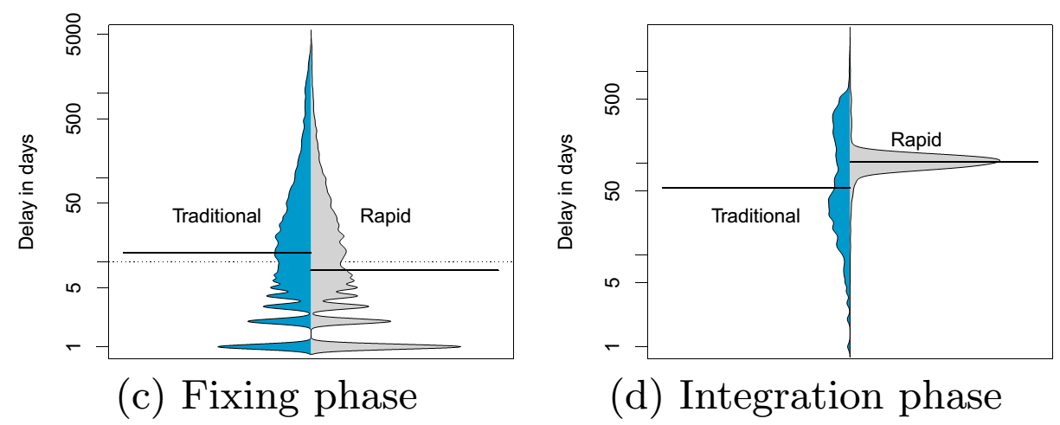
Although issues are triaged and fixed faster in rapid releases, they wait a longer time to be delivered
Notes:
Our research corroborates with results of previous research in terms that rapid releases fix issues faster than traditional releases. However, we observe that , surprisingly, traditional releases take less time to deliver addressed issues.

Slide 106
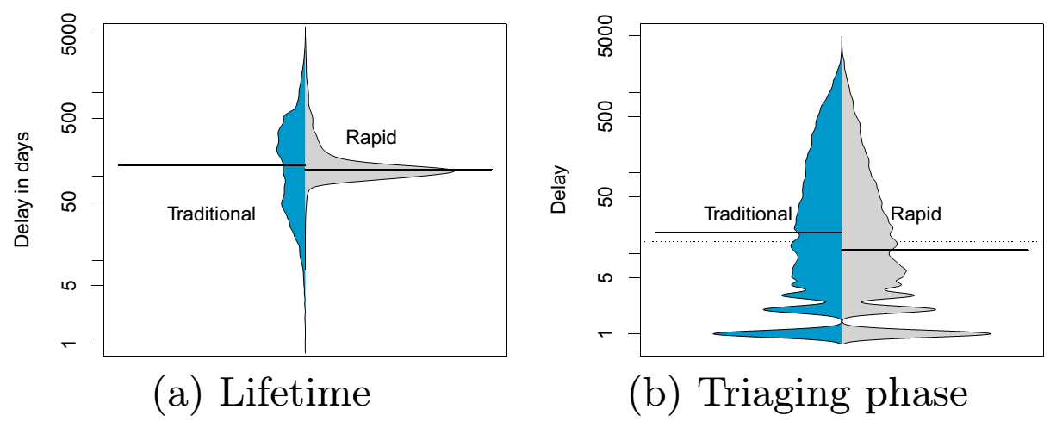
Although issues are triaged and fixed faster in rapid releases, they wait a longer time to be delivered
Notes:
We also measure the total lilfe-time of issues and we observe no significant difference between how quickly issues are opened and delivered to the users when comparing traditional and rapid releases.

Slide 107
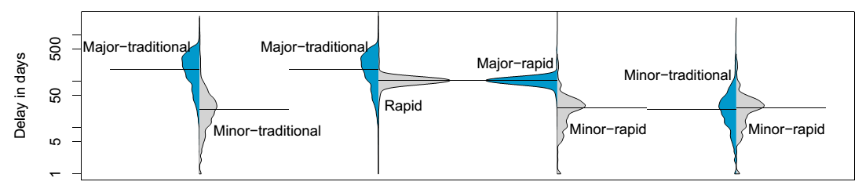
Minor-traditional releases are a key reason why traditional releases can deliver issues more quickly
Notes:
We also observe that a key reason why traditional releases can deliver addressed issues faster, is due to miner releases. For instance, the distribution associated with short delay is associated to minor releases.

Slide 108
Traditional Releases prioritize backlog issues
Notes:
As for the differences between how traditional and rapid releases prioritize the delivery of addressed issues, we observe that traditional releases prioritize backlog issues.

Slide 109
Traditional Releases prioritize backlog issues
2.0
3.0
Notes:
For example, let’s imagine that this is a traditional release cycle, and each circle represents an addressed issue over time

Slide 110
Traditional Releases prioritize backlog issues
Rank 5
2.0
3.0
Notes:
We can say that, according to the backlog, that issue has rank 5,

Slide 111
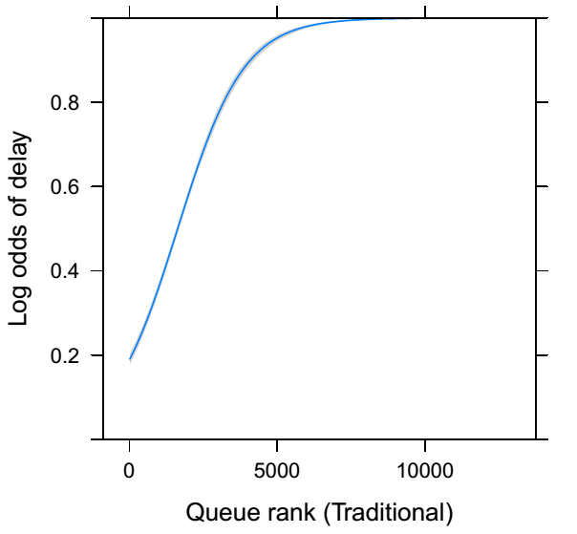
Traditional Releases prioritize backlog issues
Notes:
Than we observe that the earlier an issue is addressed in the backlog rank, the the less is the odds of an issue being delayed

Slide 112
Rapid releases prioritize issues of the current release cycle
Notes:
On the other hand, rapid releases prioritize the backlog within each release cycle.

Slide 113
Rapid releases prioritize issues of the current release cycle
2.0
3.0
Notes:
For example, let’s present that between 2.0 and 3.0 we have a rapid release cycle

Slide 114
Rapid releases prioritize issues of the current release cycle
Rank 3
2.0
3.0
Notes:
According to the backlog of that specific release cycle, the rank of the issue is 3

Slide 115
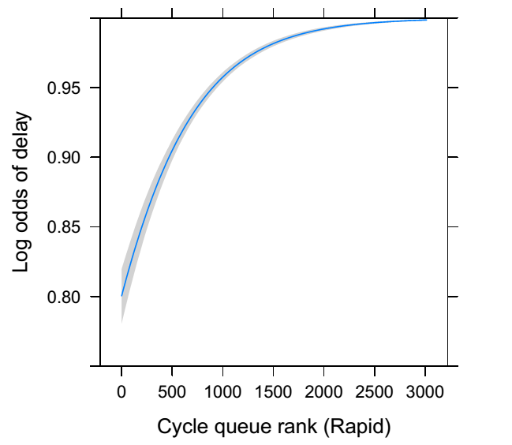
Rapid releases prioritize issues of the current release cycle
Notes:
We observe, that the higher the rank within the release cycle, the higher the probability of that addressed issue being delayed

Slide 116
Staged Delivery of Addressed Issue (Study 3)
Notes:
Finally, we intend to perform our last study about the process of stabilizing addressed issues until the moment that it’s release. To do so, we intend to study pipelining releases. For example Firefox, has nightly builds, aurora builds, and beta builds. Google chrome has also several channels in which the stability of the releases increase over time. We intend to study what are the factors that impact on the faster stabilization of addressed issues among the release channels.

Slide 117
We Intend to study how addressed issues are stabilized in pipelining releases before being delivered to users
Notes:
Finally, we intend to perform our last study about the process of stabilizing addressed issues until the moment that it’s release. To do so, we intend to study pipelining releases. For example Firefox, has nightly builds, aurora builds, and beta builds. Google chrome has also several channels in which the stability of the releases increase over time. We intend to study what are the factors that impact on the faster stabilization of addressed issues among the release channels.

Slide 118
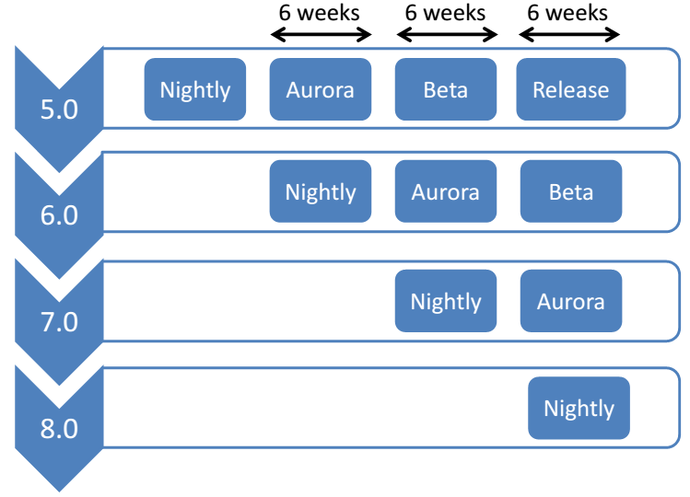
Notes:
Finally, we intend to perform our last study about the process of stabilizing addressed issues until the moment that it’s release. To do so, we intend to study pipelining releases. For example Firefox, has nightly builds, aurora builds, and beta builds. Google chrome has also several channels in which the stability of the releases increase over time. We intend to study what are the factors that impact on the faster stabilization of addressed issues among the release channels.

Slide 119
Stabilization
Notes:
Finally, we intend to perform our last study about the process of stabilizing addressed issues until the moment that it’s release. To do so, we intend to study pipelining releases. For example Firefox, has nightly builds, aurora builds, and beta builds. Google chrome has also several channels in which the stability of the releases increase over time. We intend to study what are the factors that impact on the faster stabilization of addressed issues among the release channels.

Slide 120
How much time it takes for each stabilization phase?
Notes:
And we build explanatory models to understand how delivery delay behaves in each of the release strategy.

Slide 121
How much time it takes for each stabilization phase?
Do all of the addressed issues follow the same process to be stabilized?
Notes:
And we build explanatory models to understand how delivery delay behaves in each of the release strategy.

Slide 122
How much time it takes for each stabilization phase?
Do all of the addressed issues follow the same process to be stabilized?
What are the special characteristics of those issues that are stabilized more quickly?
Notes:
And we build explanatory models to understand how delivery delay behaves in each of the release strategy.

Slide 123
How much time it takes for each stabilization phase?
Do all of the addressed issues follow the same process to be stabilized?
What are the special characteristics of those issues that are stabilized more quickly?
Measuring Stabilization Delay
Notes:
And we build explanatory models to understand how delivery delay behaves in each of the release strategy.

Slide 124
How much time it takes for each stabilization phase?
Do all of the addressed issues follow the same process to be stabilized?
What are the special characteristics of those issues that are stabilized more quickly?
Measuring Stabilization Delay
Studying the stabilization workflow of addressed issues
Notes:
And we build explanatory models to understand how delivery delay behaves in each of the release strategy.

Slide 125
How much time it takes for each stabilization phase?
Do all of the addressed issues follow the same process to be stabilized?
What are the special characteristics of those issues that are stabilized more quickly?
Measuring Stabilization Delay
Studying the stabilization workflow of addressed issues
Building explanatory models
Notes:
And we build explanatory models to understand how delivery delay behaves in each of the release strategy.

Slide 126
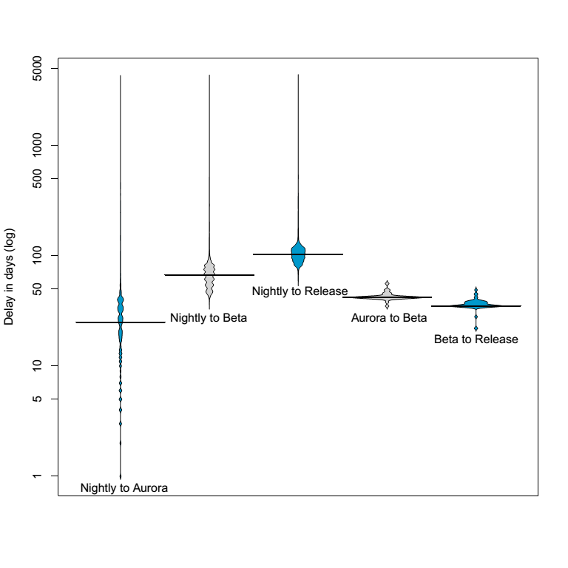

Slide 127
Conclusions
Notes:
Now we are going to talk about abnormal delay

Slide 128
Yes, delivery delay exists and it is not rare. And release strategies have some impact on such delays
Notes:
Finally, we intend to perform our last study about the process of stabilizing addressed issues until the moment that it’s release. To do so, we intend to study pipelining releases. For example Firefox, has nightly builds, aurora builds, and beta builds. Google chrome has also several channels in which the stability of the releases increase over time. We intend to study what are the factors that impact on the faster stabilization of addressed issues among the release channels.

Slide 129
We expect that by performing our empirical studies we can possibly provide some guidelines and insights to the practice
Notes:
Finally, we intend to perform our last study about the process of stabilizing addressed issues until the moment that it’s release. To do so, we intend to study pipelining releases. For example Firefox, has nightly builds, aurora builds, and beta builds. Google chrome has also several channels in which the stability of the releases increase over time. We intend to study what are the factors that impact on the faster stabilization of addressed issues among the release channels.

Slide 130
Understanding Software Delivery Delay
Daniel Alencar da Costa
Supervisor: Uirá Kulesza
Co-supervisor: Ahmed E. Hassan

